Slide 1
Bayesian Classification: Why?
A statistical classifier: performs probabilistic prediction, i.e., predicts class membership probabilities
Foundation: Based on Bayes’ Theorem.
Performance: A simple Bayesian classifier, naïve Bayesian classifier, has comparable performance with decision tree and selected neural network classifiers
Bayesian classifiers have also exhibited high accuracy and speed when applied to large databases.
Notes:
class membership probabilities such as probability that a given tuple belongs to a particular class.
Studies comparing different classification algorithms

Slide 2
Bayesian Classification
Class Conditional Independence: Naıve Bayesian classifier assume that the effect of an attribute value on a given class is independent of the values of the other attributes. This assumption is called class conditional independence.
It is made to simplify the computations involved and, in this sense, is considered “na¨ıve.”
Bayes’ Theorem:
Let X be a data sample (“evidence”): class label is unknown
Let H be a hypothesis that data tuple X belongs to class C
Classification is to determine P(H|X), (i.e., posteriori probability): the probability that the hypothesis holds given the observed data sample X

Slide 3
Bayes’ Theorem: Basics
P(H|X), is the posteriori probability of H conditioned on X. OR the H( probability that tuple X belongs to class C), given the attribute description of X.
Suppose X is a 35-year-old customer with an income of $40,000. Suppose that H is the hypothesis that our customer will buy a computer. Then P(H|X) reflects the probability that customer X will buy a computer,given that we know the customer’s age and income.
P(H) (prior probability) or the initial probability of H.
E.g., This is the probability that any given customer will buy computer, regardless of age, income, …
Similarly, P(X|H) is the posterior probability of X conditioned on H.
That is, it is the probability that a customer, X, is 35 years old and earns $40,000, given that we know the customer will buy a computer.
P(X) is the prior probability of X. E.g, it is the probability that a person from our set of customers is 35 years old and earns $40,000.
Notes:
X is described by measurements made on a set of n attributes.
P(H|X) The posterior probability, is based on more information (e.g., customer information) than the prior probability, P(H), which is independent of X.

Slide 4
Prediction Based on Bayes’ Theorem
Given training data X, posteriori probability of a hypothesis H, P(H|X), follows the Bayes’ theorem
Informally, this can be viewed as
posteriori = likelihood x prior/evidence
Predicts X belongs to C_{i} iff the probability P(C_{i}|X) is the highest among all the P(C_{k}|X) for all the k classes
Practical difficulty: It requires initial knowledge of many probabilities, involving significant computational cost

Slide 5
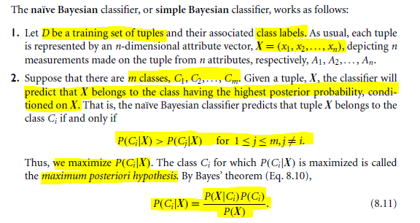
Classification Is to Derive the Maximum Posteriori

Slide 6
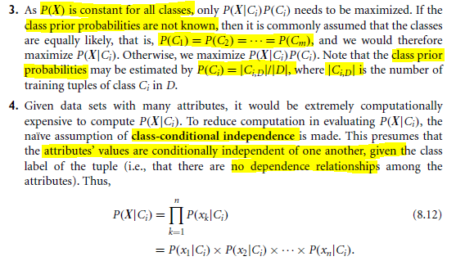
Naïve Bayes Classifier

Slide 7
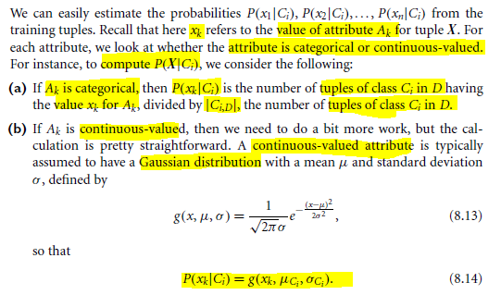

Slide 8
Naïve Bayes Classifier: Training Dataset
Class:
C1:buys_computer = ‘yes’
C2:buys_computer = ‘no’
Data to be classified:
X = (age <=30,
Income = medium,
Student = yes
Credit_rating = Fair)

Slide 9
Naïve Bayes Classifier: An Example
P(C_{i}): P(buys_computer = “yes”) = 9/14 = 0.643
P(buys_computer = “no”) = 5/14= 0.357
Compute P(X|C_{i}) for each class
P(age = “<=30” | buys_computer = “yes”) = 2/9 = 0.222
P(age = “<= 30” | buys_computer = “no”) = 3/5 = 0.6
P(income = “medium” | buys_computer = “yes”) = 4/9 = 0.444
P(income = “medium” | buys_computer = “no”) = 2/5 = 0.4
P(student = “yes” | buys_computer = “yes) = 6/9 = 0.667
P(student = “yes” | buys_computer = “no”) = 1/5 = 0.2
P(credit_rating = “fair” | buys_computer = “yes”) = 6/9 = 0.667
P(credit_rating = “fair” | buys_computer = “no”) = 2/5 = 0.4
X = (age <= 30 , income = medium, student = yes, credit_rating = fair)
P(X|C_{i}) : P(X|buys_computer = “yes”) = 0.222 x 0.444 x 0.667 x 0.667 = 0.044
P(X|buys_computer = “no”) = 0.6 x 0.4 x 0.2 x 0.4 = 0.019
P(X|C_{i})*P(C_{i}) : P(X|buys_computer = “yes”) * P(buys_computer = “yes”) = 0.028
P(X|buys_computer = “no”) * P(buys_computer = “no”) = 0.007
Therefore, X belongs to class (“buys_computer = yes”)

Slide 10
Avoiding the Zero-Probability Problem
Naïve Bayesian prediction requires each conditional prob. be non-zero. Otherwise, the predicted prob. will be zero
Ex. Suppose a dataset with 1000 tuples, income=low (0), income= medium (990), and income = high (10)
Use Laplacian correction (or Laplacian estimator)
Adding 1 to each case
Prob(income = low) = 1/1003
Prob(income = medium) = 991/1003
Prob(income = high) = 11/1003
The “corrected” prob. estimates are close to their “uncorrected” counterparts
Notes:
991/1003 and 990/1003 almost have same value

Slide 11
The Naive Bayesian Classifier
●
The Naive Bayesian classifier is based on Bayes’ theorem with independence assumptions between predictors
A Naive Bayesian model is easy to build, with no complicated iterative parameter estimation which makes it particularly useful for very large datasets
Despite its simplicity, the Naive Bayesian classifier often does surprisingly well and is widely used because it often outperforms more sophisticated classification methods
●
●
Notes:
Knowing the value of one attribute has nothing to do with the values of another attribute (predictor).
It is well know among research community.It is easy to understand, explain and debug

Slide 12
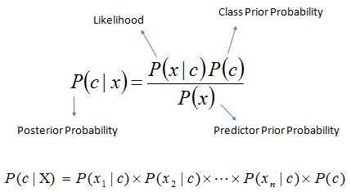
How it works
●
Bayes theorem provides a way of calculating the posterior probability, P(c|x), from P(c), P(x), and P(x|c)
NB classifier assumes that the effect of the value of a predictor (x) on a given class (c) is independent of the values of other predictors. This assumption is called class conditional independence
●
●
P(c|x) is the posterior probability of class (target) given predictor (attribute)
P(c) is the prior probability of class
P(x|c) is the likelihood which is the probability of predictor given class
P(x) is the prior probability of predictor
●
●
●
Notes:
P(C) is prob of class. P(X) is the prob of data(our predictors/attributes). Predictors are independent of each other
P(C) is prior prob of class before seeing any data.
P(x1|c) prob of first attribute given the class. P(x2|c) prob of second attribute given the class

Slide 13
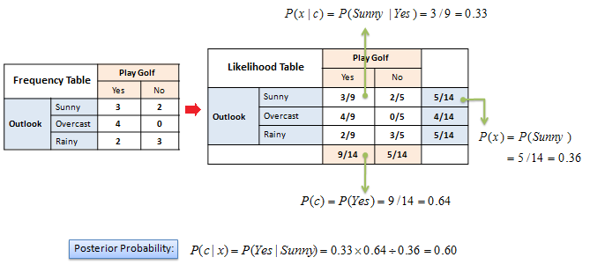
Example
●
The posterior probability can be calculated by first, constructing a frequency table for each attribute against the target
Then, transforming the freq. tables to likelihood tables and finally using the Naive Bayesian equation to calculate the posterior probability for each class
The class with the highest posterior probability is the outcome of prediction
●
●
Notes:
P(sunny) regardless of the class is 5/14
P(yes/sunny)= p(sunny/yes) * p(Yes/ p(sunny)
P(No/sunny)= p(sunny/No) * p(No)/ p(sunny)

Slide 14
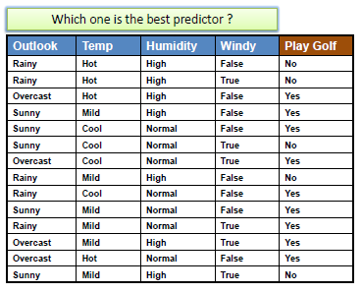
Example
P(Yes) = 9 / 14
P(No) = 5 /14
Notes:
Whether data- 4 categorical attributes and a class. Prob of class yes.. Prob of class No..

Slide 15
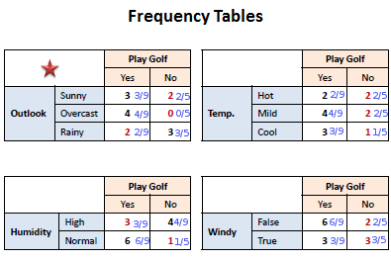
Example
Notes:
Prob of sunny given yes..3/9 prob of sunny given No=2/5.
9 is the sum of yes colums because we have 9 yes

Slide 16
Example
Let's assume we have a day with: Outlook = Rainy
Temp = Mild Humidity = Normal Windy = True
Likelihood of Yes = P(Outlook=Rainy|Yes)*P(Temp=Mild|Yes)*P(Humidity=Normal| Yes)*P(Windy=True|Yes)*P(Yes) =
2/9 * 4/9 * 6/9 * 3/9 * 9/14 = 0.014109347
Likelihood of No = P(Outlook=Rainy|No)* P(Temp=Mild|No)*P(Humidity=Normal| No)*P(Windy=True|No)*P(No) =
3/5 * 2/5 * 1/5 * 3/5 * 5/14 = 0.010285714
Now we normalize:
P(Yes) = 0.014109347/(0.014109347+0.010285714) = 0.578368999
P(No) = 0.010285714/(0.014109347+0.010285714) = 0.421631001
●
●

Slide 17
Example
Let's assume we have a day with: Outlook = Rainy
Temp = Mild Humidity = Normal Windy = True
Likelihood of Yes = P(Outlook=Rainy|Yes)*P(Temp=Mild|Yes)*P(Humidity=Normal| Yes)*P(Windy=True|Yes)*P(Yes) =
2/9 * 4/9 * 6/9 * 3/9 * 9/14 = 0.014109347
Likelihood of No = P(Outlook=Rainy|No)* P(Temp=Mild|No)*P(Humidity=Normal| No)*P(Windy=True|No)*P(No) =
3/5 * 2/5 * 1/5 * 3/5 * 5/14 = 0.010285714
Now we normalize:
P(Yes) = 0.014109347/(0.014109347+0.010285714) = 0.578368999
P(Yes) = 0.010285714/(0.014109347+0.010285714) = 0.421631001
●
●

Slide 18
The zero-frequency problem
●
When an attribute value (Outlook=Overcast) doesn’t occur with every class value (Play Golf=no). No training data available(Overcast, No)
Add 1 to all the counts
●
Notes:
Since we multiply probabilities, and we have zero count then we end up with 0. We add 1 to the all the counts in outlook, temp, humidity and windy

Slide 19
It makes sense, but when you have a model with many features, the entire probability will become zero because one of the feature’s value was zero. To avoid this, we increase the count of the variable with zero to a small value (usually 1) in the numerator, so that the overall probability doesn’t become zero.
This correction is called ‘Laplace Correction’. Most Naive Bayes model implementations accept this or an equivalent form of correction as a parameter.

Slide 20
Numerical Predictors
●
Numerical variables need to be transformed to their categorical counterparts (binning) before constructing their frequency tables
The other option we have is using the distribution of the numerical variable to have a good guess of the frequency
For example, one common practice is to assume normal distributions for numerical variables
●
●

Slide 21
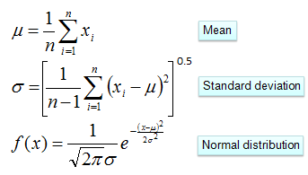
Normal Distribution
●
The probability density function for the normal distribution is defined by two parameters (mean and standard deviation)
Notes:
For each numerical variable or attribute or predictor, we assume that each one has a normal distribution then we calculate mean and SD

Slide 22
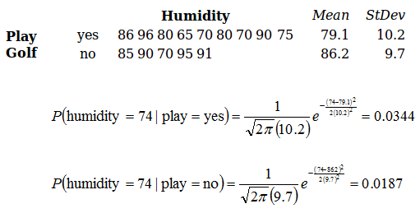
Example of Numerical Predictors
Notes:
Numerical data set—attribute humidity under consideration. If we have humidity 4 than we play or not

Slide 23
Decision Tree
●
Decision tree builds classification or regression models in the form of a tree structure
It breaks down a dataset into smaller and smaller subsets while at the same time an associated decision tree is incrementally developed
The final result is a tree with decision nodes and leaf nodes.
●
●
–
A decision node (e.g., Outlook) has two or more branches (e.g., Sunny, Overcast and Rainy)
Leaf node (e.g., Play) represents a classification or decision
–
●
The topmost decision node in a tree which corresponds to the best predictor called root node
Decision trees can handle both categorical and numerical data
●
Notes:
Decision tree classifier can be used for classification and regression.
Leaf nodes has no branches and has/represent classes

Slide 24
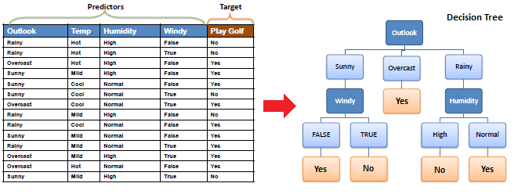
Decision Tree for Weather Data
Notes:
We have root node outlook and then we have branch fro sunny, overcast and rainy.
Then for the sunny, the best way to branch now is on windy.
For overcast we have always yes. For rainy, we can probably split/branch on humidity. Temperature has not used at all.

Slide 25
How it works
●
The core algorithm for building decision trees called ID3 by J. R. Quinlan which employs a top-down, greedy search through the space of possible branches with no backtracking
ID3 uses Entropy and Information Gain to construct a decision tree
●
Notes:
Search all possible branches and choose the best branch

Slide 26
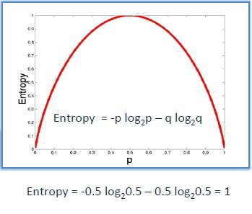
Entropy
●
A decision tree is built top-down from a root node and involves partitioning the data into subsets that contain instances with similar values (homogeneous)
ID3 algorithm uses entropy to calculate the homogeneity of a sample
If the sample is completely homogeneous the entropy is zero and if the sample is an equally divided it has entropy of one
●
●
Notes:
Entropy is a measure of uncertainty. It is computed for 2 0r may be 3 classes/categories. Entropy is zero if all values belong to the same
Entropy is 1 if instances are equally divided i.e 5 belong to yes and 5 belong to No. Entropy is Y axis and prob on x axis.

Slide 27
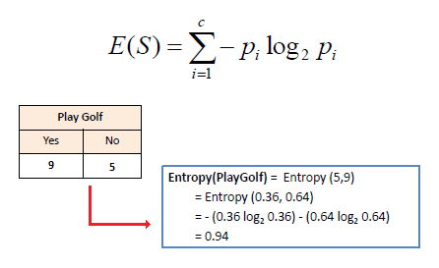
Compute Two Types of Entropy
●
To build a decision tree, we need to calculate two types of entropy using frequency tables as follows:
a) Entropy using the frequency table of one attribute
(Entropy of the Target S):
●
Notes:
Log 2 of any value is negative. Therefore leading minus will cancel each other and become positive.
Entropy of target (s). It has 2 classes yes and nO. Pi represents prob of class (yes or no).
Entropy(5,9) is Entropy of yes and no. Prob of Yes is 9/14 and Prob of No is 5/14

Slide 28
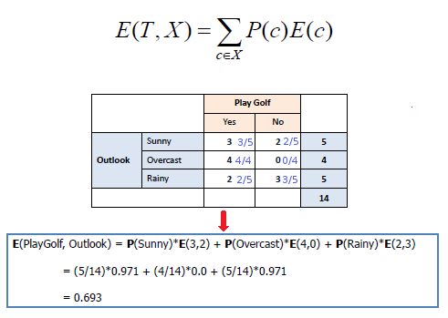
E(3,2)=-(3/5log2(3/5))-(2/5log2(2/5))
●
b) Entropy using the frequency table of two attributes:
Compute the entropy for target(playgolf) when we split by outlook.
Build frequency table for outlook attribute against class values (yes/No).
Concerned about rows since we use categories (sunny, overcast , rainy) of outlook variable to split the data.
P(c) is prob of category(sunny)
E(C) entropy values of category(sunny) i.e E(3,2)
Notes:
Split using outlook. Focus on frequency table of outlook. We build frequency table against class values (yes/No).
We use the categories (sunny, overcast and rainy) of outlook variable to split the data therefore we are concerned about the rows.
Prob (sunny/yes)=3/5… Prob(sunny) regardless of any class is 5/14.. Prob (sunny/No)=2/5
P(C) is prob of category (sunny) E(C) is entropy of that category. So prob of sunny * entropy of values of sunny for classes yes/no(3,2)
We compute the entropy for target(playgolf) when we split by outlook

Slide 29
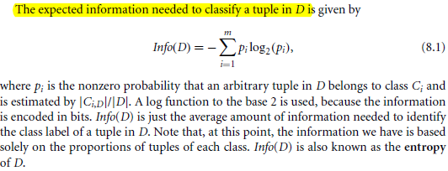

Slide 30
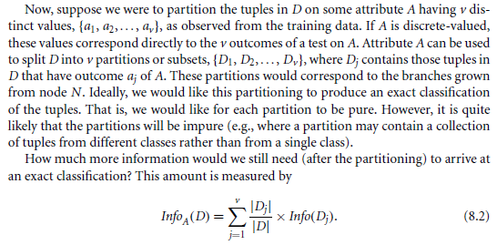

Slide 31

Information Gain
●
The information gain is based on the decrease in entropy after a dataset is split on an attribute
●
Constructing a decision tree is all about finding attribute that returns the highest information gain (i.e., the most homogeneous branches) or lowest entropy
Notes:
Information gain is entropy before splitting – entropy after splitting

Slide 32

Predictors Contribution
●
Kononenko's information gain as a sum of information contributed by each attribute can offer an explanation on how values of the predictors influence the class probability

Slide 33
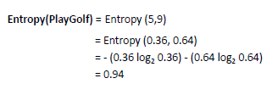
Example
●
Step 1: Calculate entropy of the target.

Slide 34
Example
●
Step 2: The dataset is then split on the different attributes. The entropy for each branch is calculated.
Then it is added proportionally, to get total entropy for the split.
The resulting entropy is subtracted from the entropy before the split.
The result is the Information Gain, or decrease in entropy.
●
●
●
Notes:
We consider one predictor at a time, we split according to certain criteria. i.e we split according to the attribute that has highest information gain

Slide 35
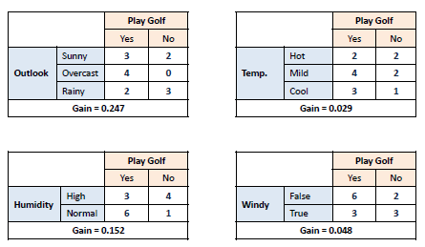
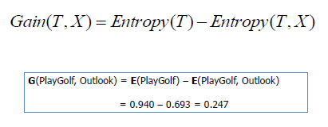
Example
Notes:
Frequency tables for different attributes

Slide 36
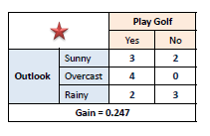
Example
●
Step 3: Choose attribute with the largest information gain as the decision node.

Slide 37
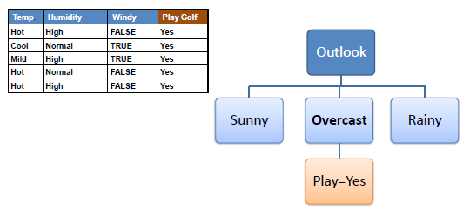
Example
●
Step 4a: A branch with entropy of 0 is a leaf node.
Explanation
Notes:
For overcast, all instances have yes class so entropy is zero. Outlook has 3 branches

Slide 38
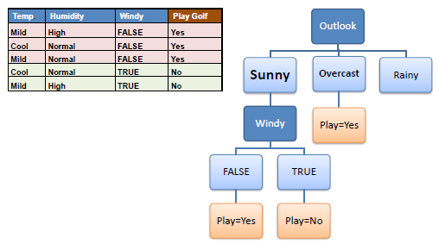
Example
●
Step 4b: A branch with entropy more than 0 needs further splitting.
Notes:
We split the sunny branch with the one that gives us highest information gain.

Slide 39
Example
●
Step 5: The ID3 algorithm is run recursively on the non- leaf branches, until all data is classified.

Slide 40
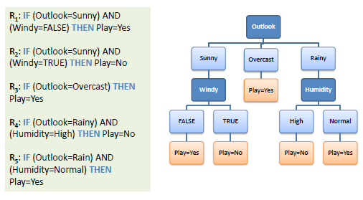
Decision Tree to Decision Rules
●
A decision tree can easily be transformed to a set of rules by mapping from the root node to the leaf nodes one by one.

